Slide 1
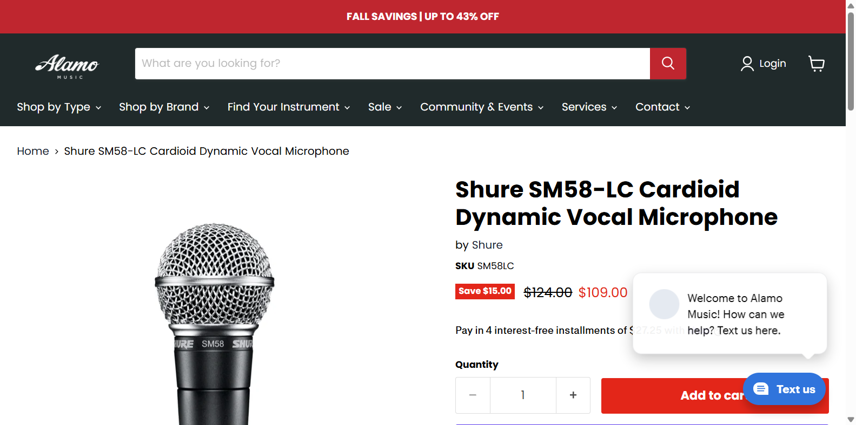
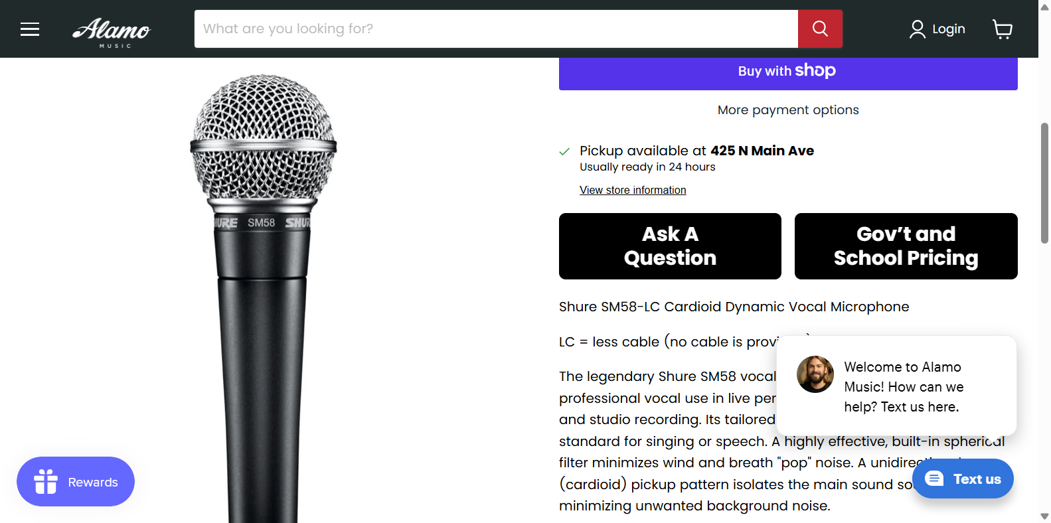
How the agent works: observe → decide → act → verify
Real step 2 from our run (openai/gpt-4.1, browser-use 0.13.11), headed Chrome, fresh profile
1 OBSERVE
2 DECIDE
3 ACT
4 VERIFY
Goal:
Scroll down the page to search for shipping cost information or any note about free shipping.
Reasoning:
I have navigated to the product page for the Shure SM58-LC Cardioid Dynamic Vocal Microphone on alamomusic.com. The product title and SKU match the requested model (SM58-LC, new, no cable). The price is clearly shown as $109.00. I need to check the page for shipping information—whether shipping is ...
Action(s): scroll
[{"scroll": {"down": true, "pages": 1.0}}]
(timing for each step is in the report)
Screenshot + page elements the agent saw
Same agent, next step: did it work?
Agent says: Scroll action succeeded, but no explicit shipping cost or free shipping note is visible yet.
Notes:
Observe: the agent gets a screenshot and the page's interactive elements. Decide: the model writes a goal and picks an action. Act: the framework executes click/type/scroll/navigate. Verify: at the next step the model judges whether the page changed as hoped. Everything on this slide comes from one real step in our run; the full log is in the HTML report.

Slide 2
Same task, two approaches: measured
Mean of repeated runs; success = every item returned and its price re-verified on the page
Task | Agent time | Agent cost | Agent requests | Agent success | Agent consistency | Det. time | Det. cost | Det. requests | Det. success | Det. consistency
Fallback: 3 books | 73 s | $0.138 | 9 model calls + 9 page loads | 0/3 | 3/3 identical | 4.8 s | $0 | 6 HTTP requests | 3/3 | 3/3 identical
Live: 3 shops | 54 s | $0.068 | 5 model calls + 4 page loads | 0/3 | 3/3 identical | 1.7 s | $0 | 2 HTTP requests | 0/3 | 3/3 identical
• Agent: prices right 9/9 on the books, but it reported a product URL it never visited in 3/3 runs, so strict success is 0/3. Our independent re-fetch caught it.
• Live: both approaches lost one shop. Sweetwater showed a human-verification page: the agent was stopped without touching it, plain HTTP got 403. Two shops verified OK.
• Deterministic: fast, free, repeatable, but one extractor per site, breaks if layout changes, and cannot see shipping that is not in the static page.
• Honest limits: 3 runs, one model (gpt-4.1), one day; the check re-reads pages with a deterministic parser.
Notes:
Numbers are measured from the runs in the runs folder (COMPARISON.md has the per-run detail and the limits).

Slide 3
When to use a browser agent, and when to use an API
Use a browser agent when:
Use an API or structured data when:
• there is no API or data feed
• many different sites, layouts you do not control
• the answer is only visible after rendering or interaction
• one-off or low-volume research tasks
Guard it: allow-list, step and time limits, read-only, verify the output
• a documented API or feed exists
• the same sites are read again and again
• you need speed, low cost, exact repeatability
• results feed other systems or decisions
Expect: one extractor per site, maintenance when pages change
Best of both: let the agent explore and extract once, then turn what it learned into a deterministic extractor for the sites you keep using.
Never trust an agent's own 'done': check the numbers independently (our check caught a made-up product URL in every fallback run).
Notes:
Conclusion: agents trade cost and speed for flexibility. Use structured data where it exists; use an agent where it does not; verify either way.

